Slide 1
To replace with my own drawing

Slide 2
CSS143 Computer Programming (II)

Slide 3
Final Exam
Wednesday 12/16 5:45pm – 7:00pm
Short lecture afterward about dependency injection (optional)

Slide 4

Clean Code

Slide 5
Clean Code
Don’t Repeat Yourself

Slide 6
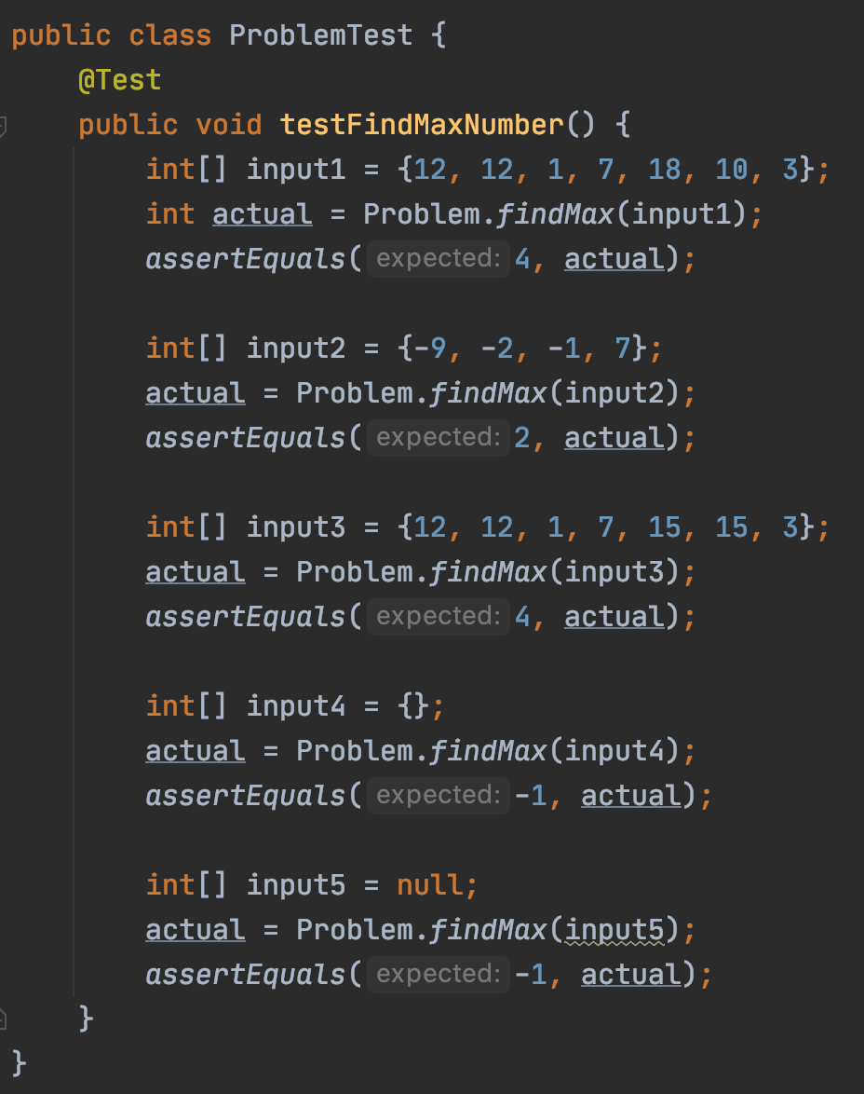
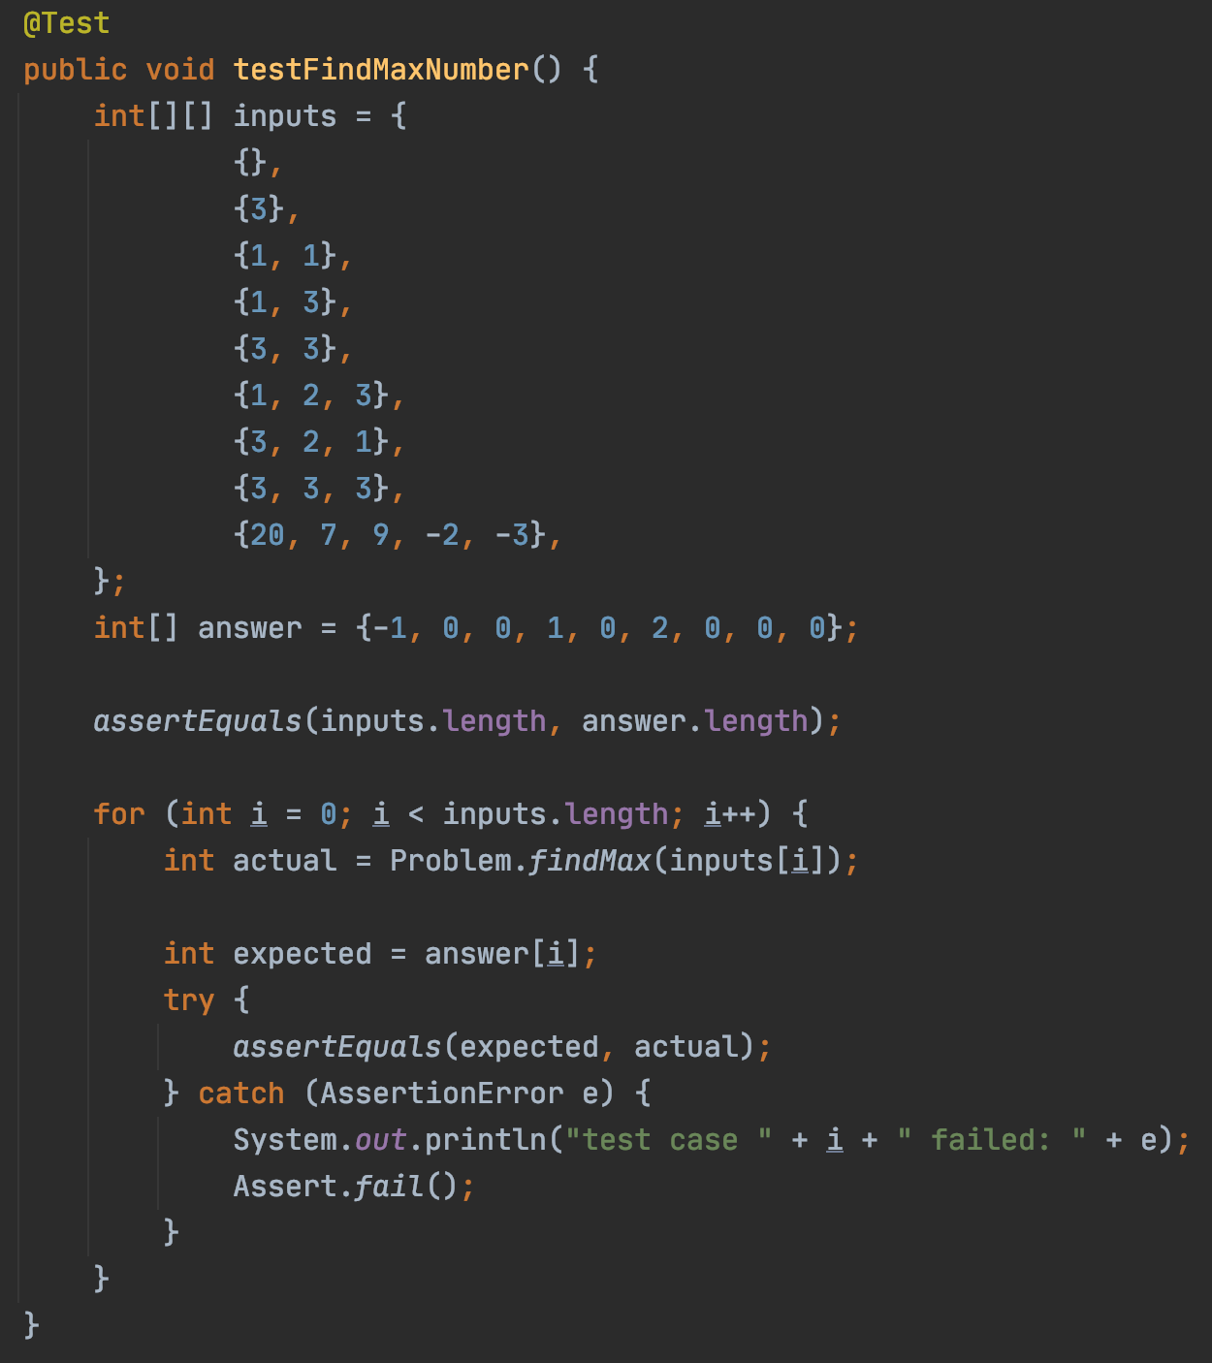
“Don’t Repeat Yourself”

Slide 7
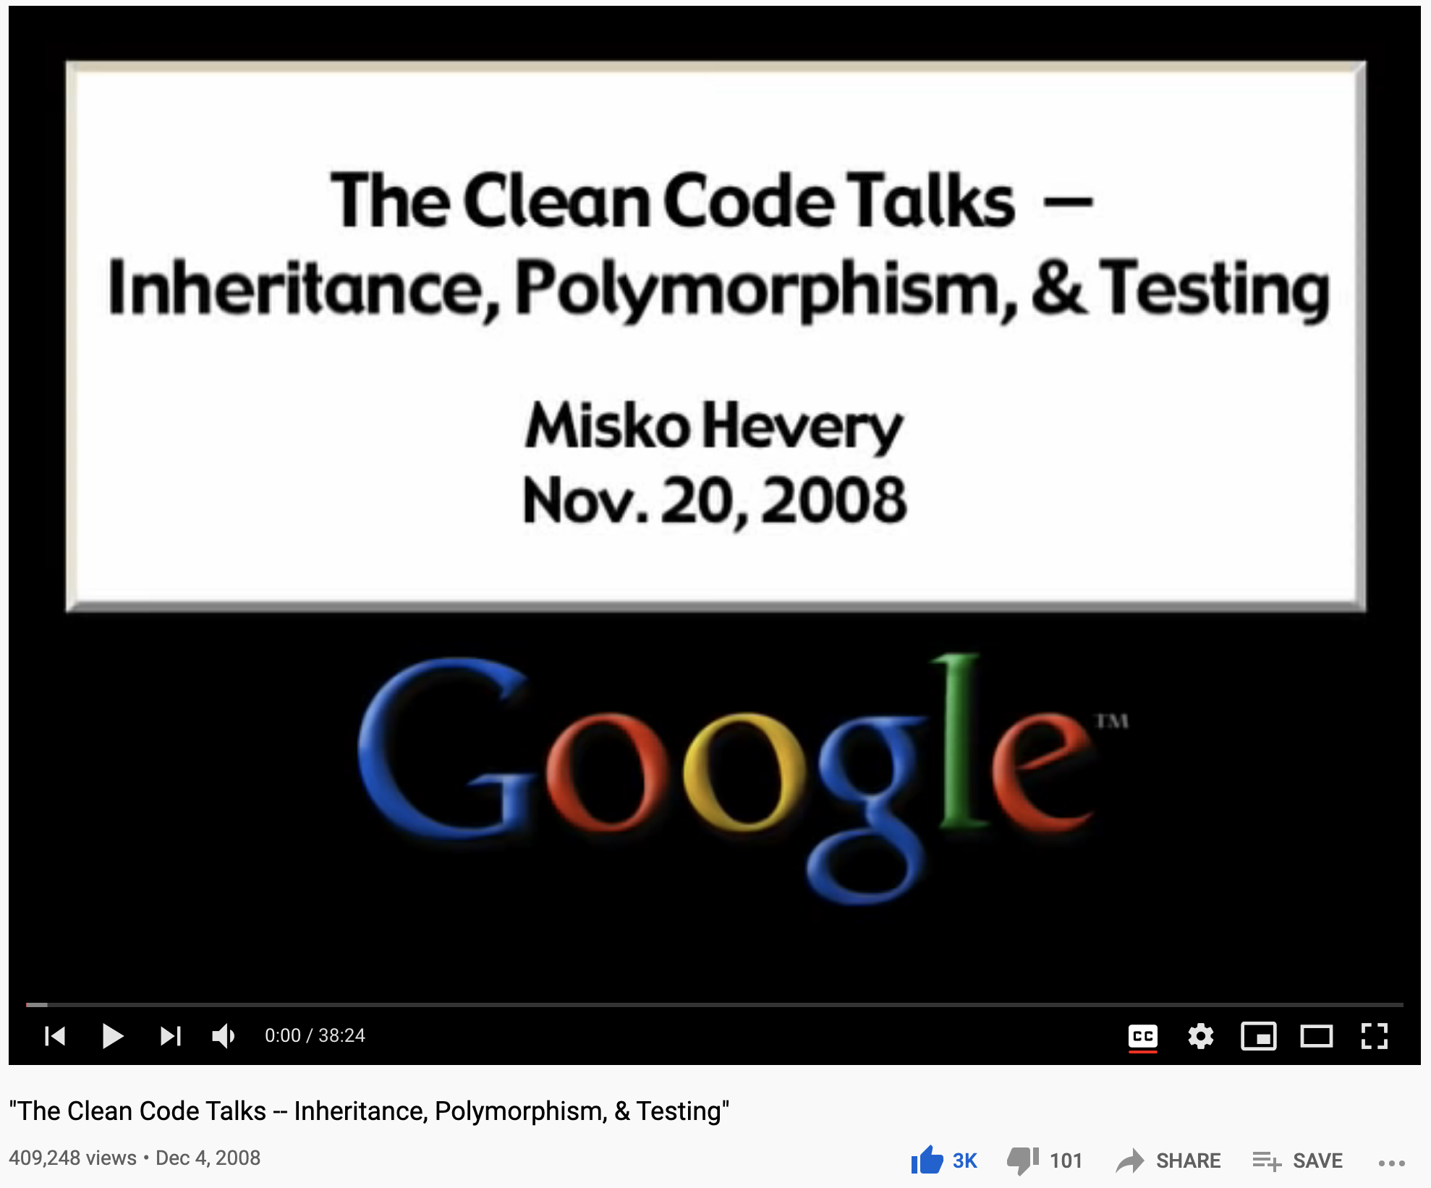
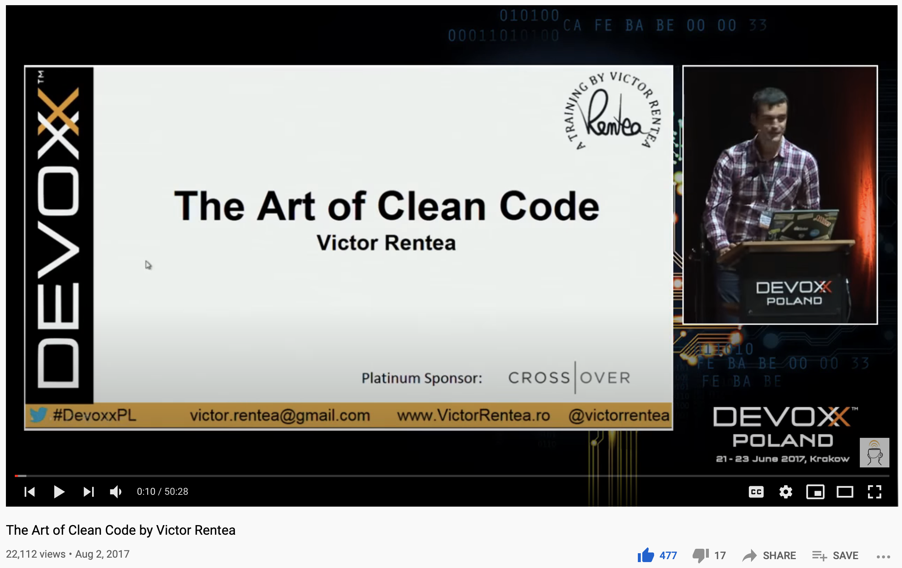
More on Clean Code
https://youtu.be/4F72VULWFvc
https://youtu.be/AeWbJ5LIFNg

Slide 8

Software Testing

Slide 9
Coding Procedures
First, write Tests
Test should fail
Then, implement Feature
Test should pass
And then, refactor
Test should still Pass

Slide 10
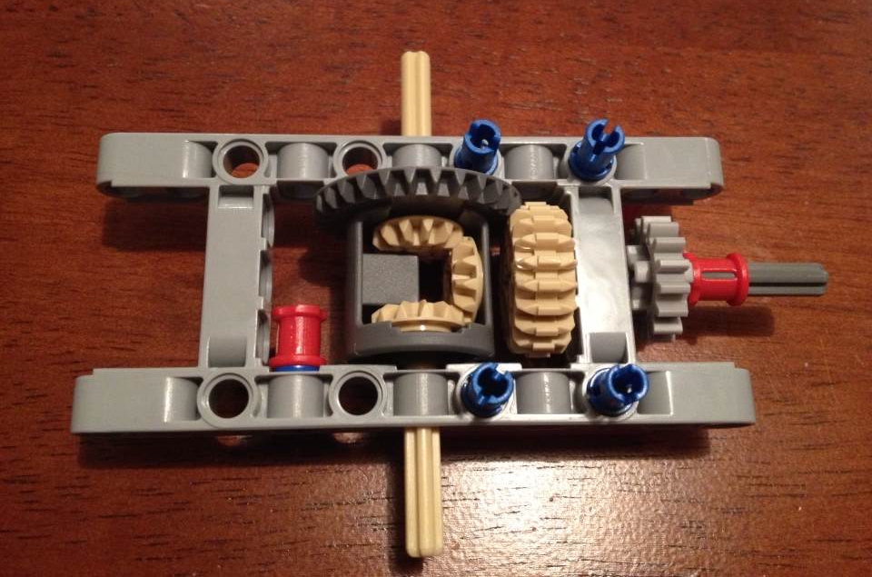
A Correctness Problem
Input:
Torque on drive shaft
Output:
Torque on wheel axles
Function:
Axles rotate independently
How do you test this differential?

Slide 11
Testing
Why testing?
1. Validation
Is your code correct?
2. Prevent regression
Can your code be damaged by some else?

Slide 12


What do you do when a bug is found and to be fixed?
Fix the bug in the function
2. Fix the bug in the function and add a test for it
3. Add a test first, see it fails,
then fix the bug in the function,
and see the test pass

Slide 13
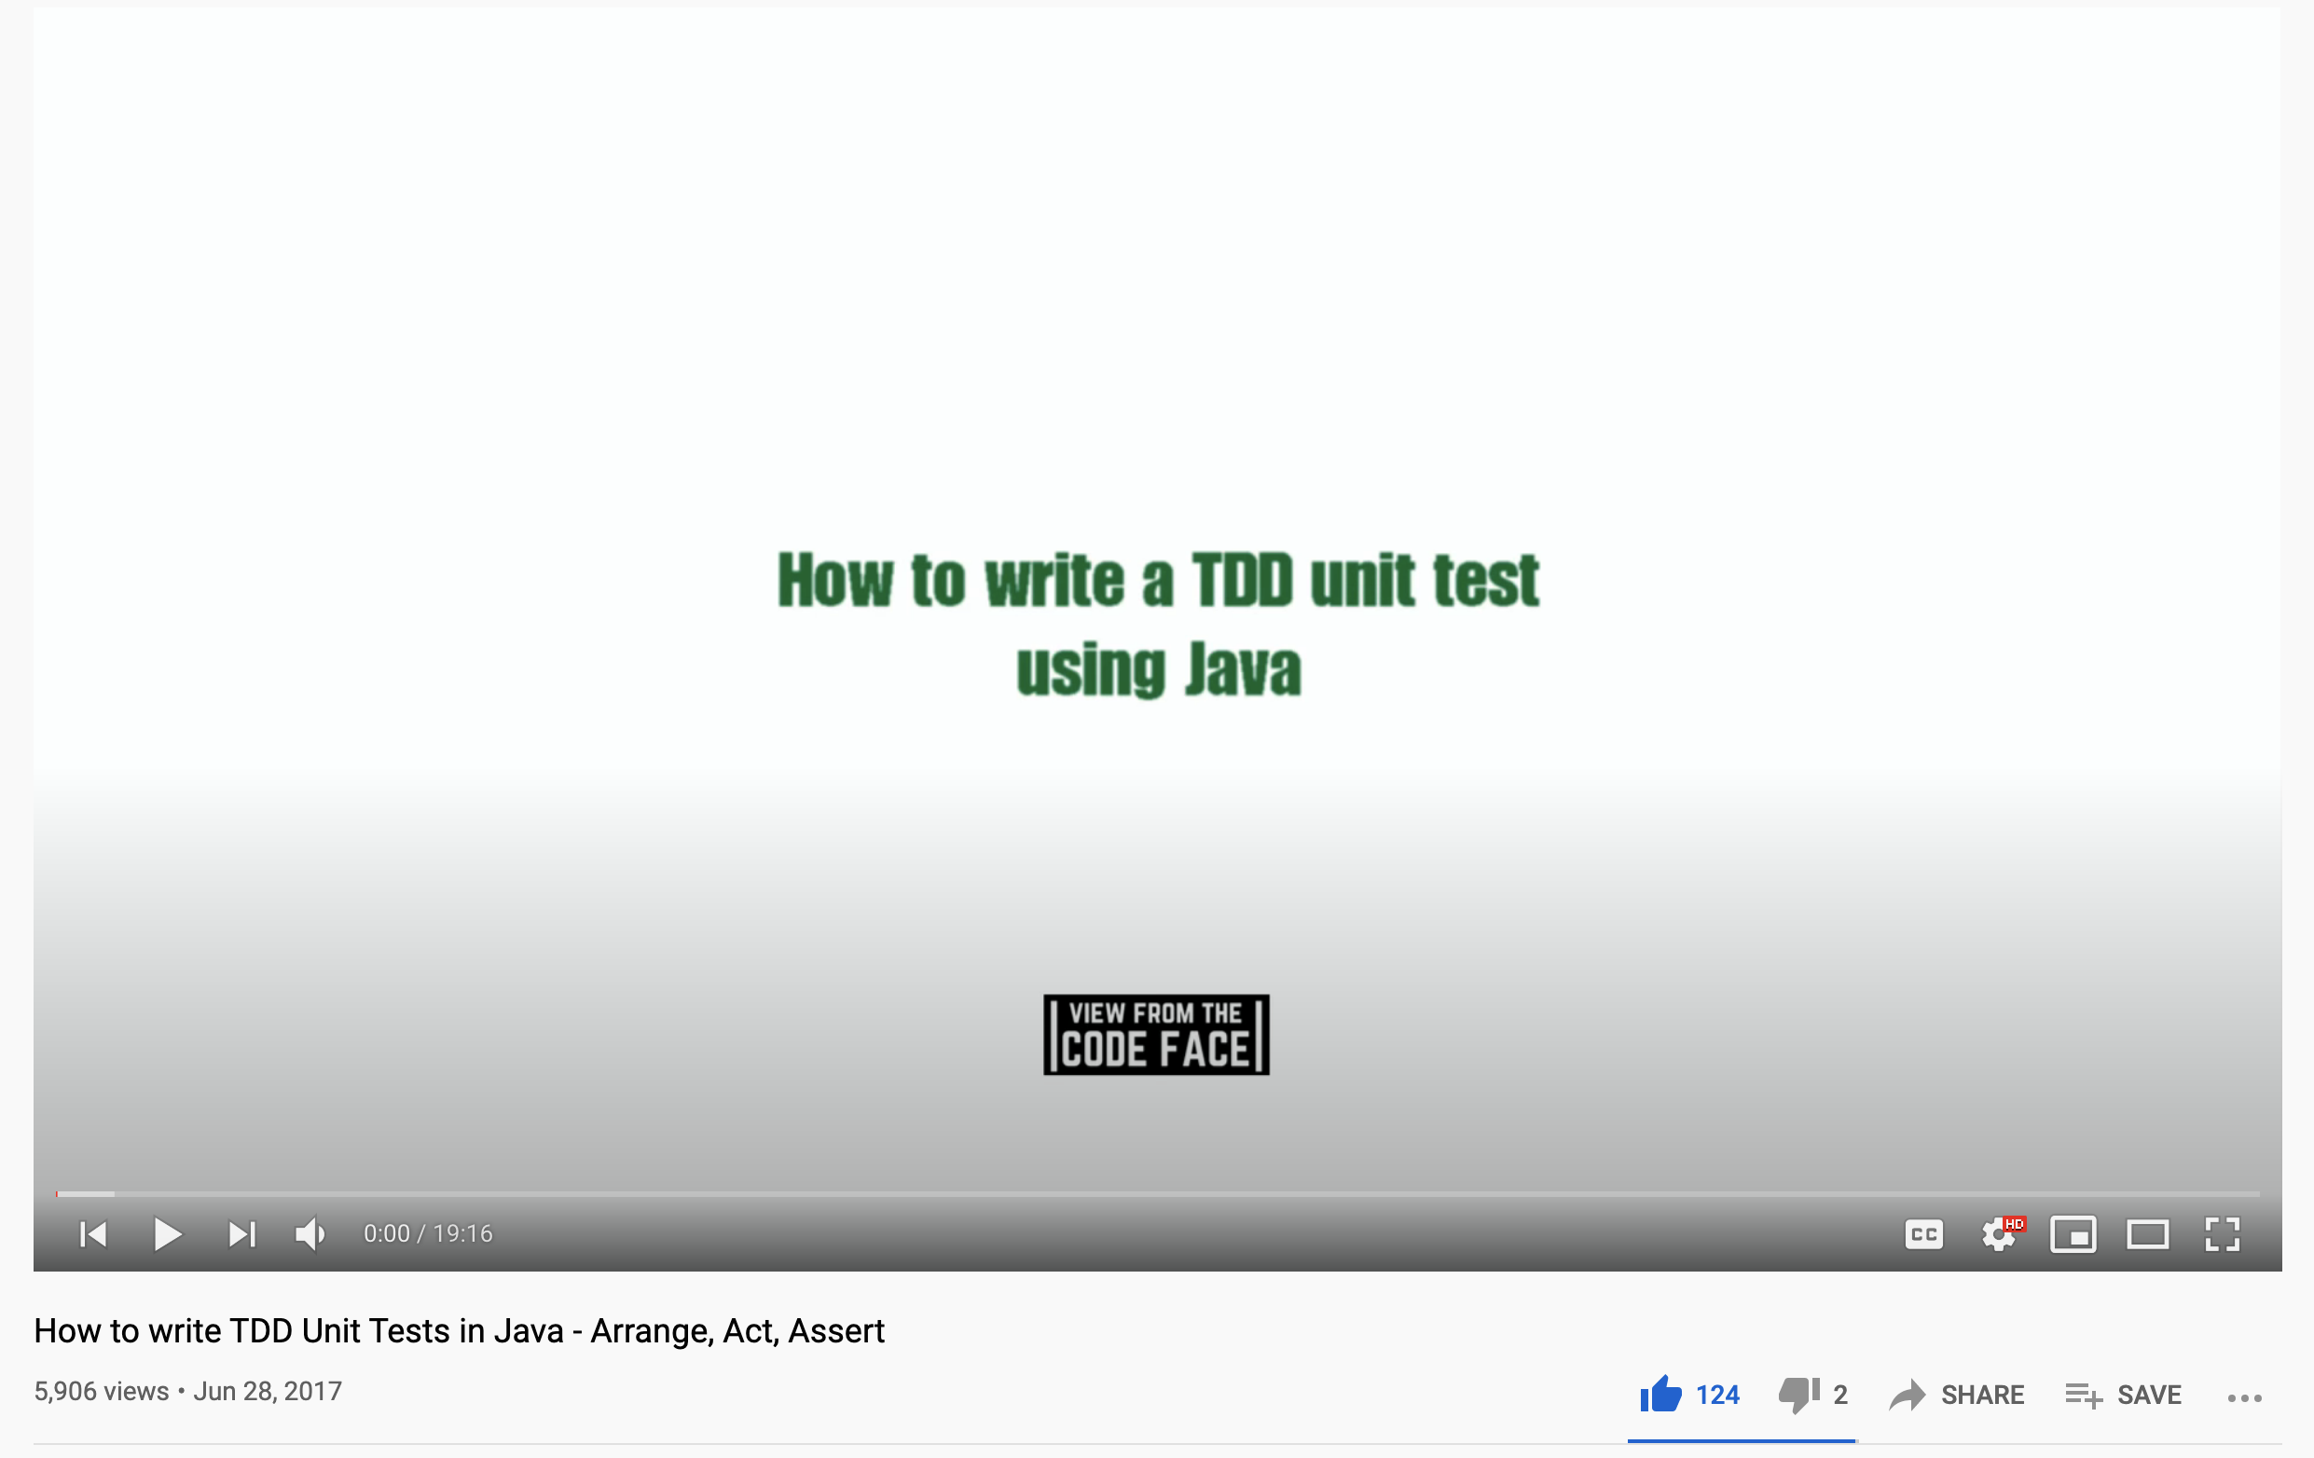
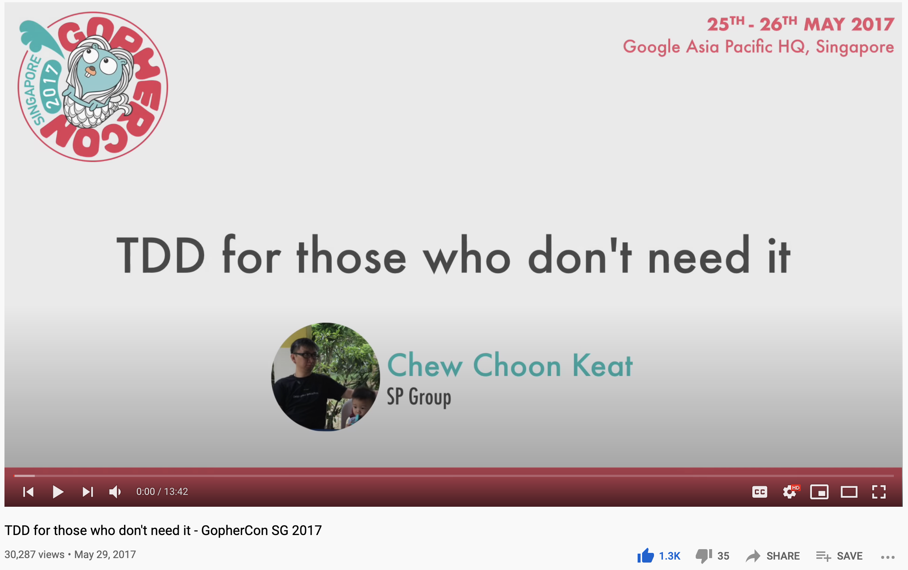
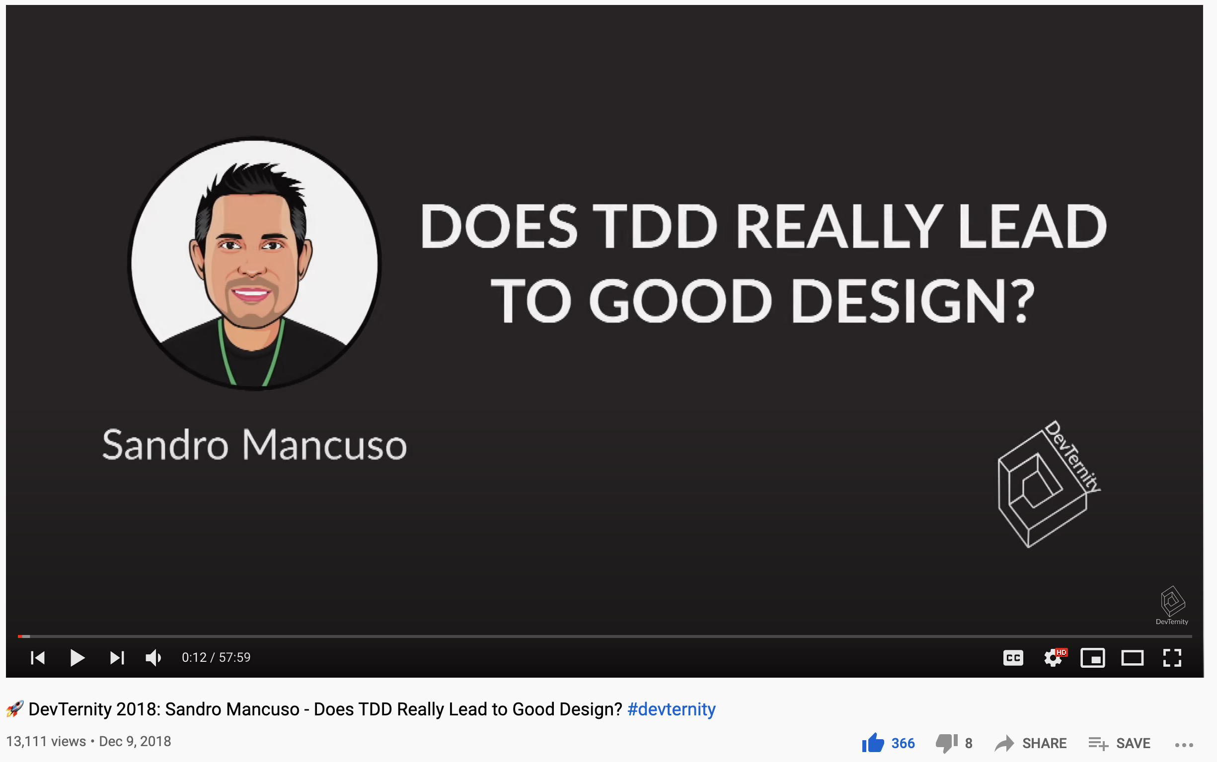
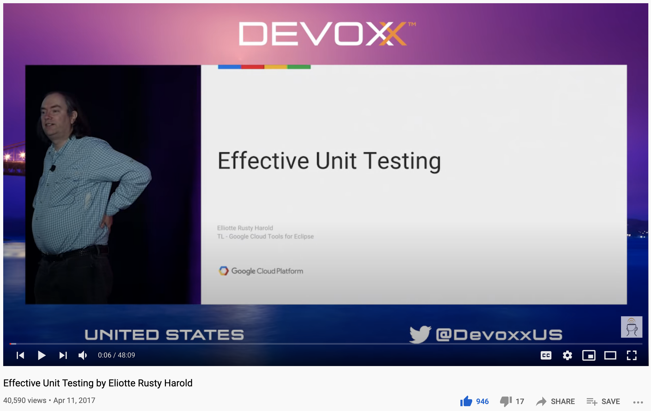
Test Driven Development
https://youtu.be/d1EAyR_NCOA
https://youtu.be/a6oP24CSdUg
https://youtu.be/KyFVA4Spcgg
https://youtu.be/fr1E9aVnBxw

Slide 14
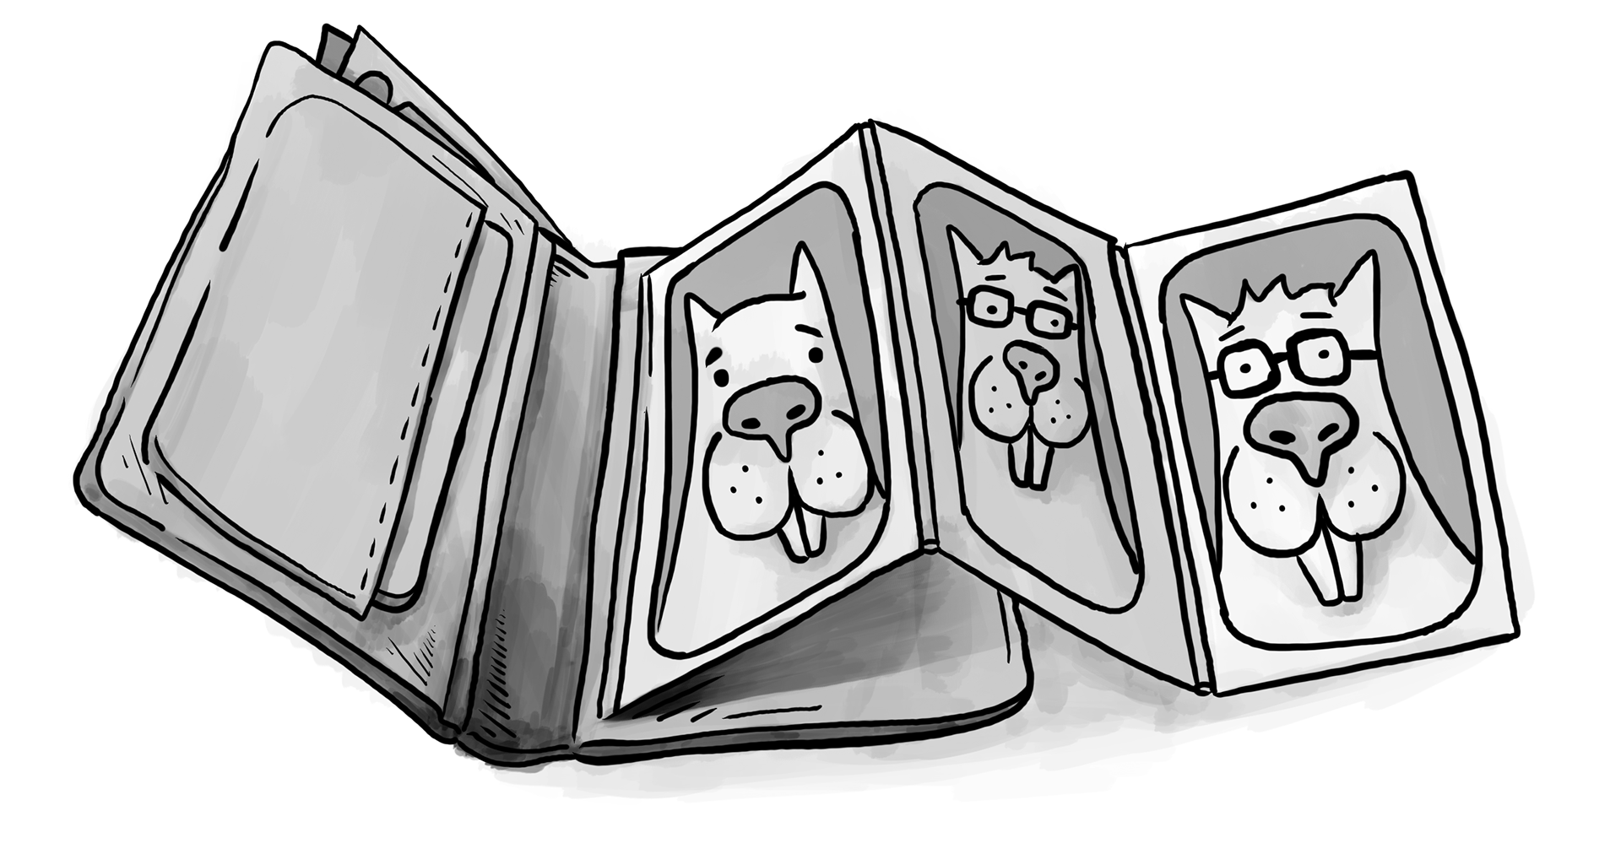
Object Oriented Programming

Slide 15
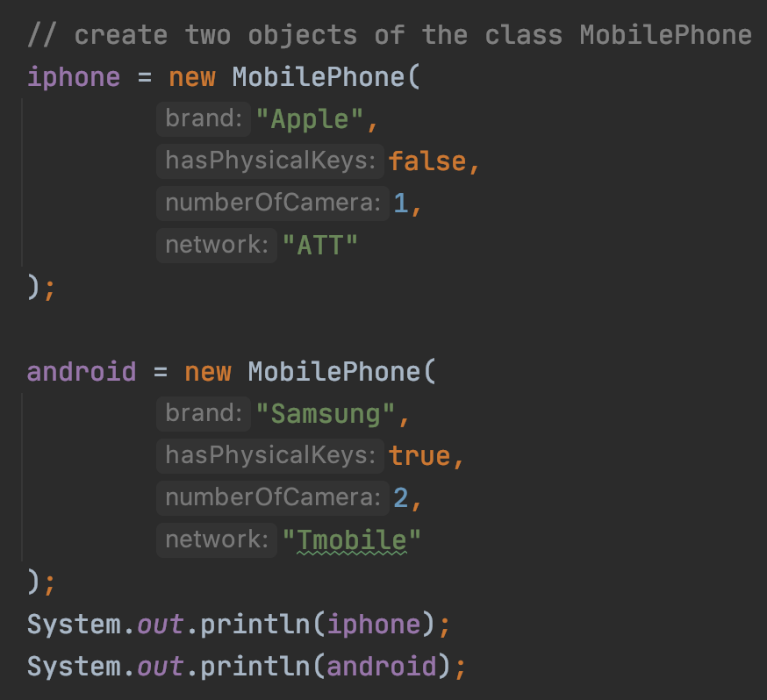
Class vs Object vs Instance vs Reference
iphone reference
0
2
1
2
iphone object
3
4
5
android reference
6
9
7
8
9
android object
10
11
Object/Instance

Slide 16
Polymorphism
Animal Class
public void play()
Dog Class
Cat Class
public void play()
public void play()
https://github.com/pdgetrf/OOBPet

Slide 17
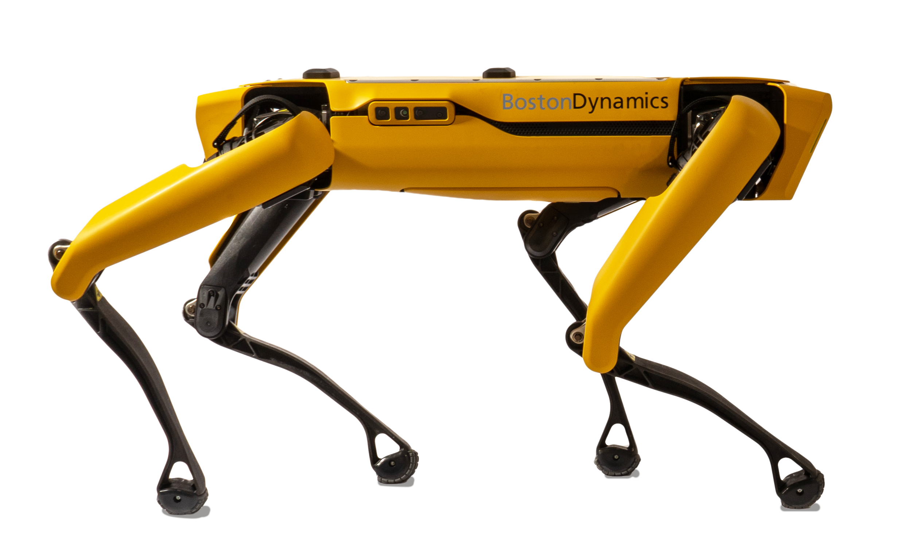
Cat
Animal
extends
Dog
interface CommonActions
implements
RobotAnimal
RobotDog
Full code https://github.com/pdgetrf/OOBPet.git

Slide 18
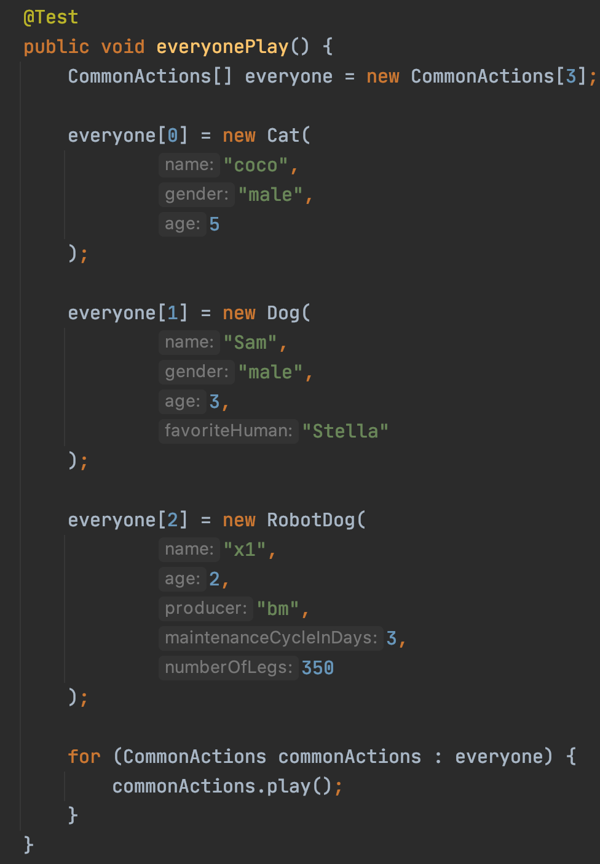
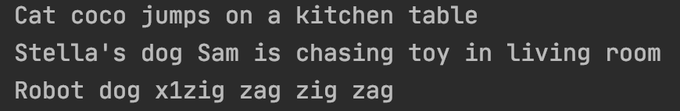
Now let’s have everyone play
https://github.com/pdgetrf/OOBPet/blob/using_interface/src/test/java/PetsOOPTest.java

Slide 19
OOP Review Summary
Encapsulation
Class vs Object/Instance vs Reference
Default access
Private member vs public method (setter/getter)
Inheritance
Base class and derived class
Calling base class copy constructor
Override vs Overload
Polymorphism
Accessing derived class object using base class reference

Slide 20
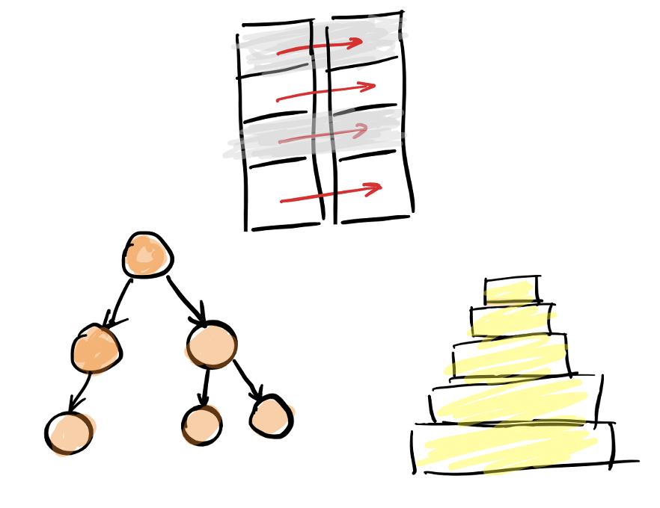
Abstract Data Type (ADT)

Slide 21
Abstract Data Type (ADT)
Interface
Public functions
Implementation
- Internal details

Slide 22
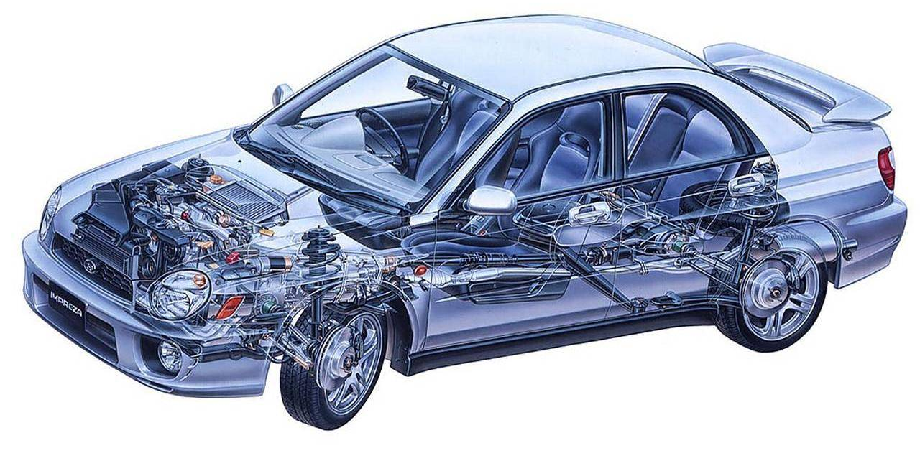
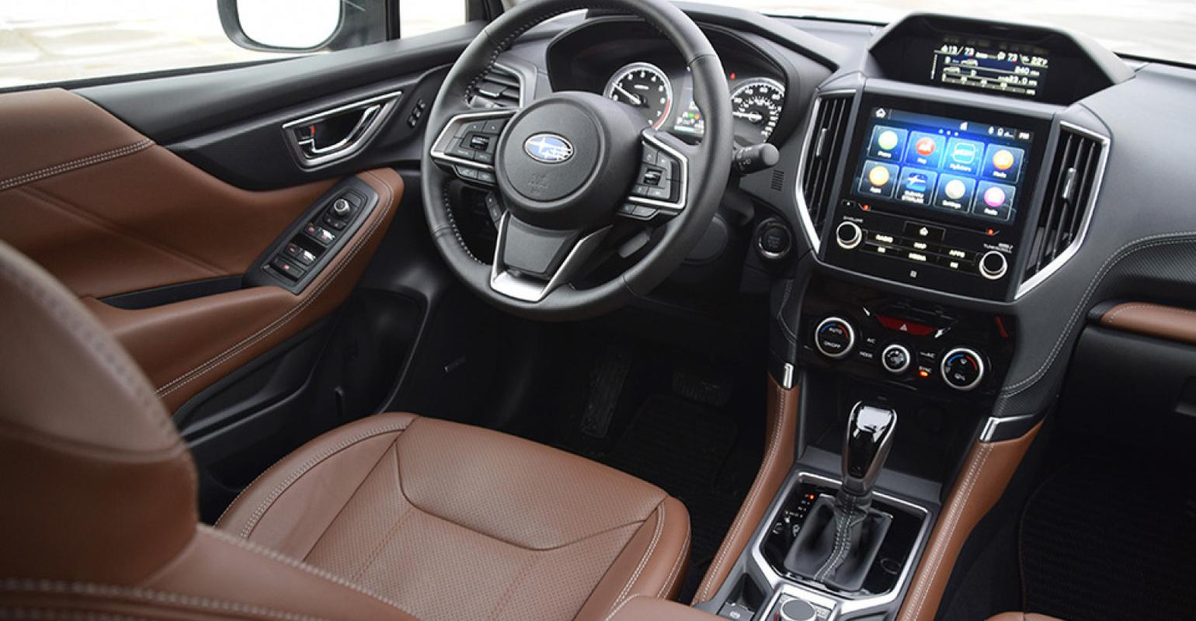
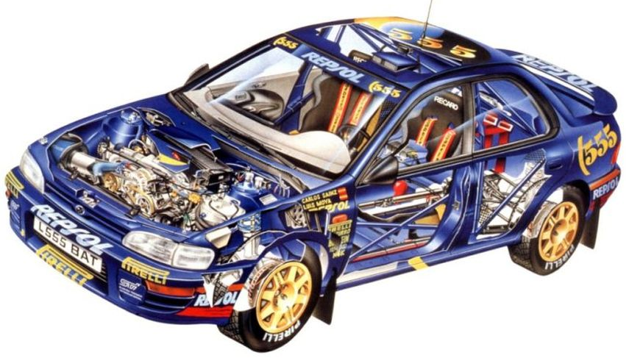
“Interface vs Implementation”

Slide 23
ADT Queue
ADT Queue
Interface
add()
poll()
size()
Implementation
Public Access
Linked List
Array

Slide 24
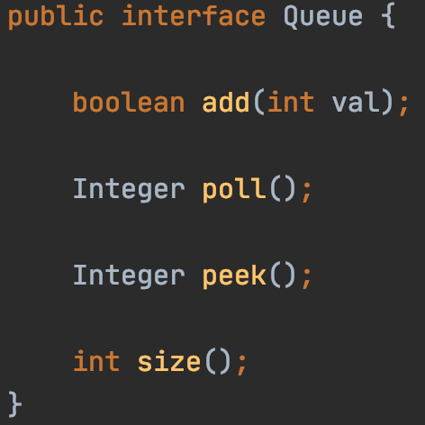
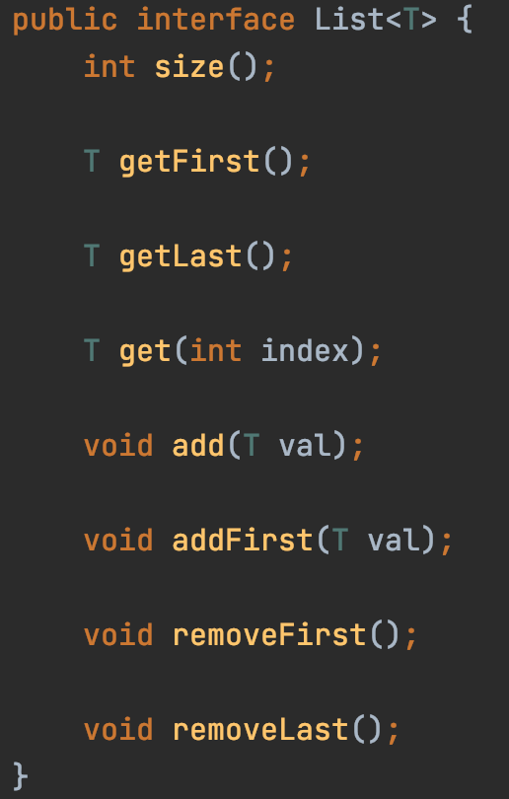
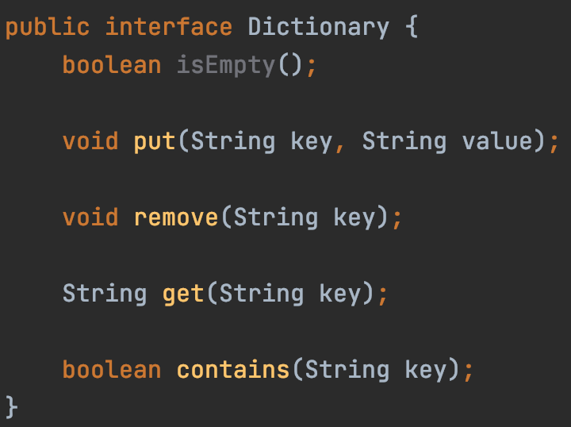
Abstract Data Type (ADT)
Interface
Public functions

Slide 25

ADT: Queue
List
Array
12
12
1
7
18
10
3
(Single) Linked List
head
12
12
12
1
7
18
10
3
null
Interface
Implementation

Slide 26
Queue ADT
poll()
12
12
12
1
7
18
10
3
12
1
7
18
10
3
add(…)
First In First Out

Slide 27
Stack ADT
push(…)
12
12
12
1
7
18
10
3
12
1
7
18
10
3
pop()
First In Last Out

Slide 28
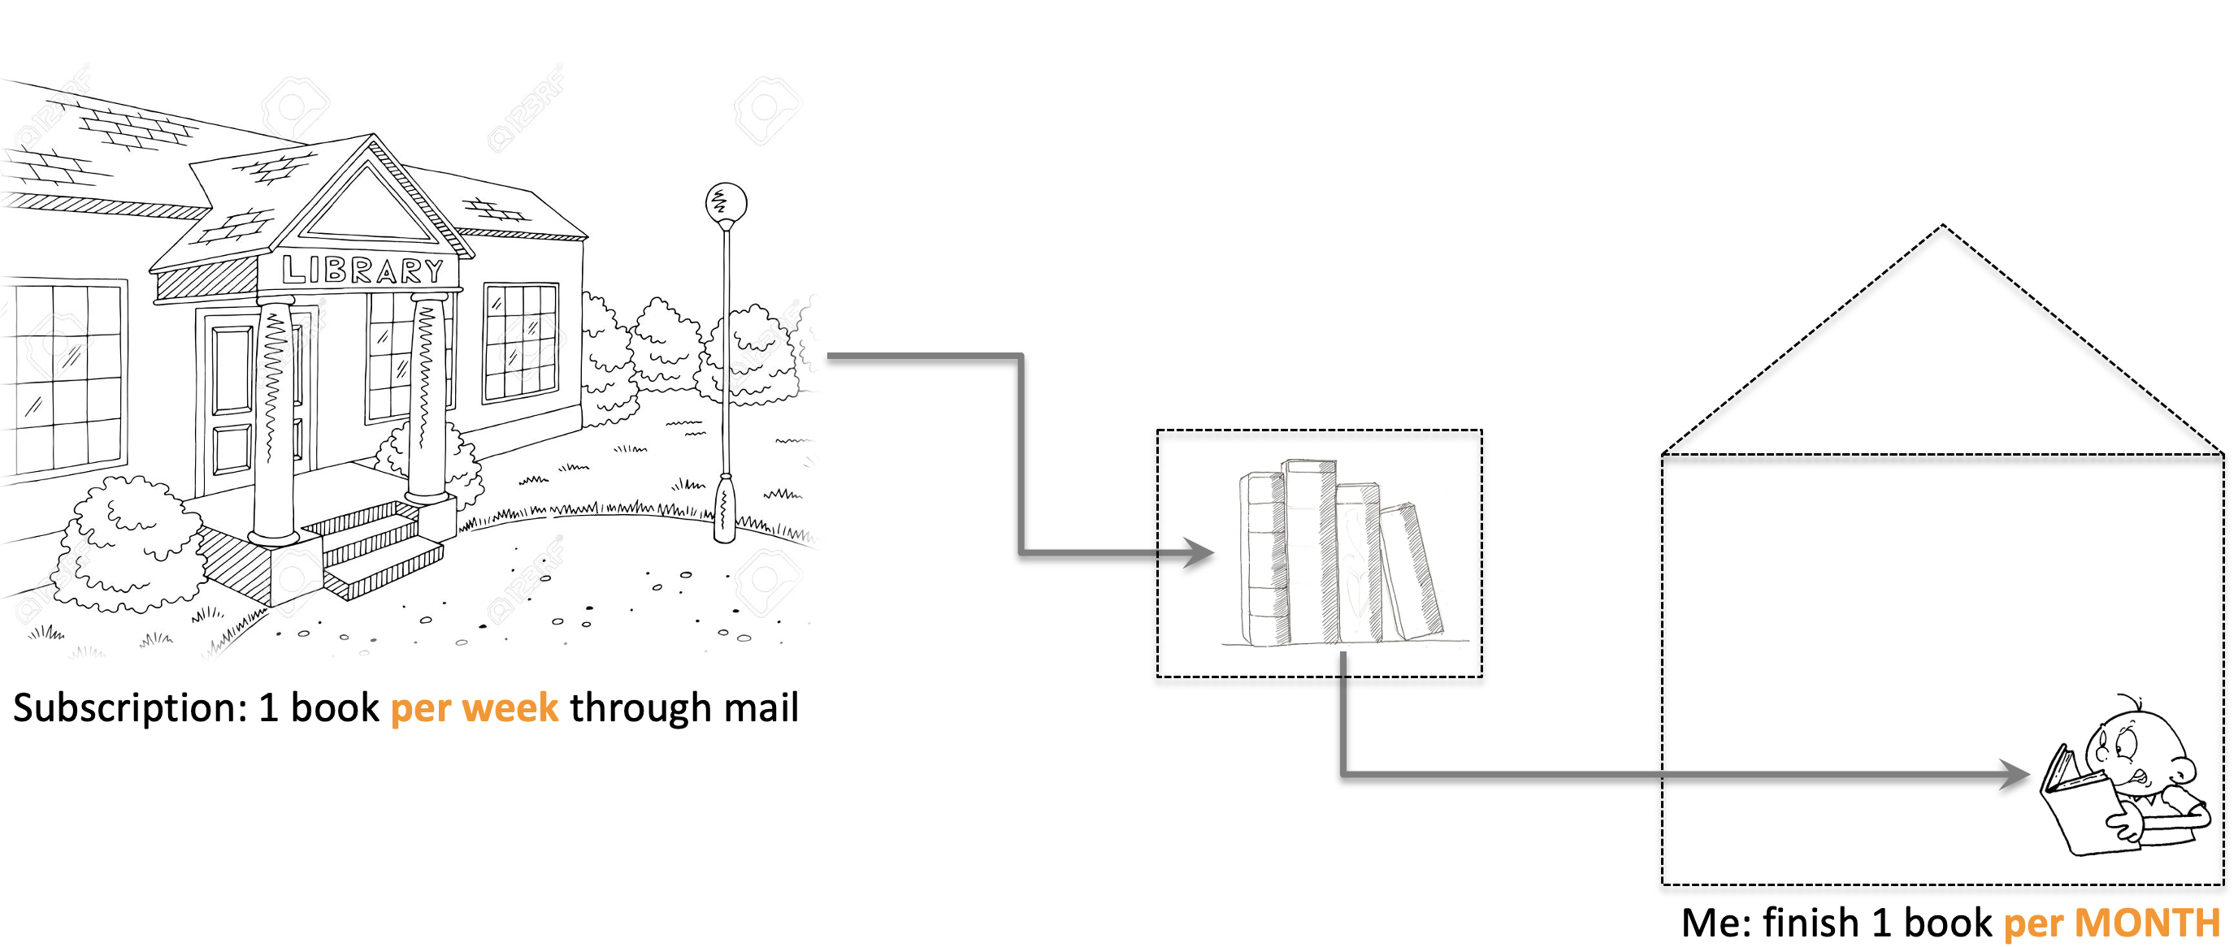
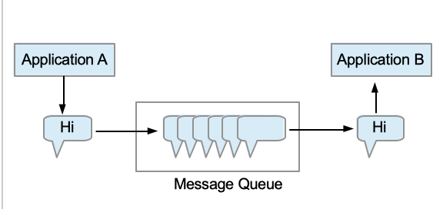
Applications
Queue
allows working at different speeds

Slide 29
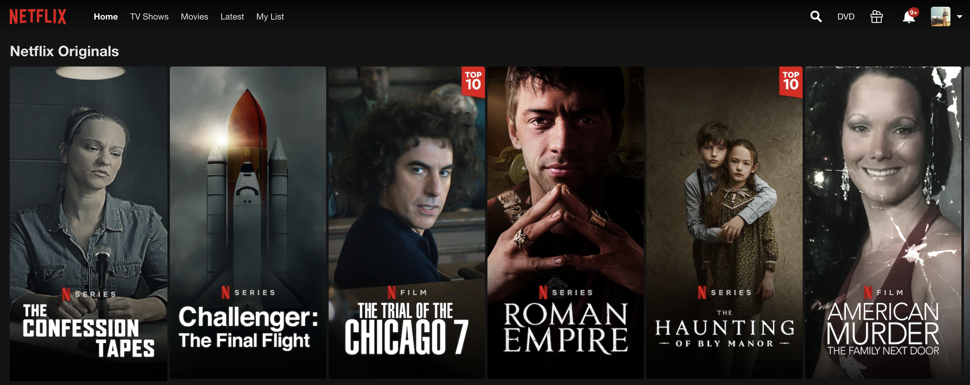
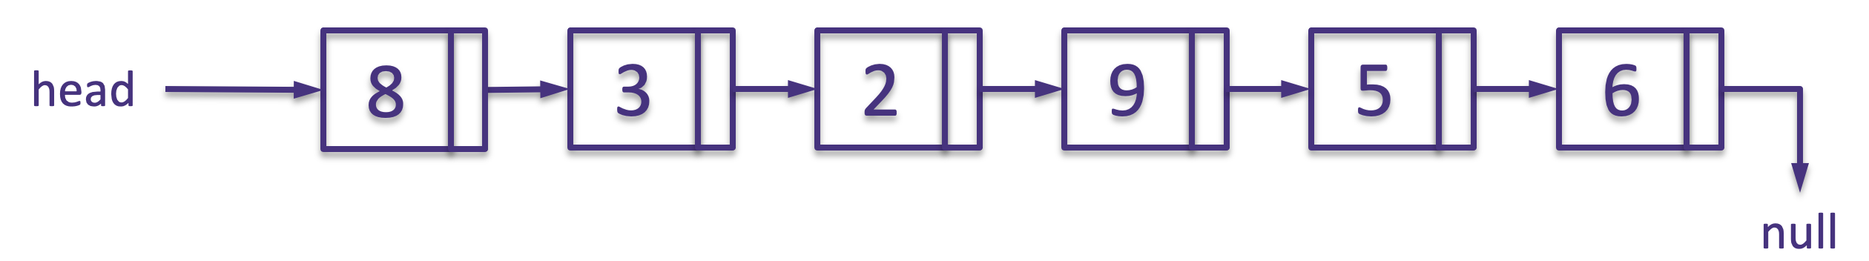
When to use Stack ADT?
”I’ll do something else first,
and then come back to continue”
Stack
Netflix watching
Print a linked list reversely
Validate parentheses
”( [ ( ) ( ) ] )”

Slide 30
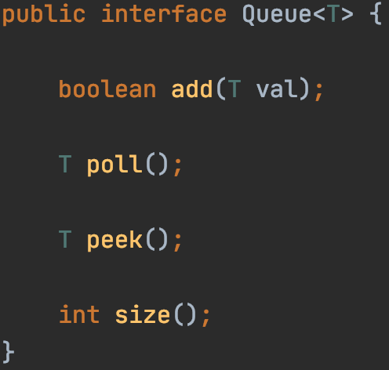
Java Generics

Slide 31
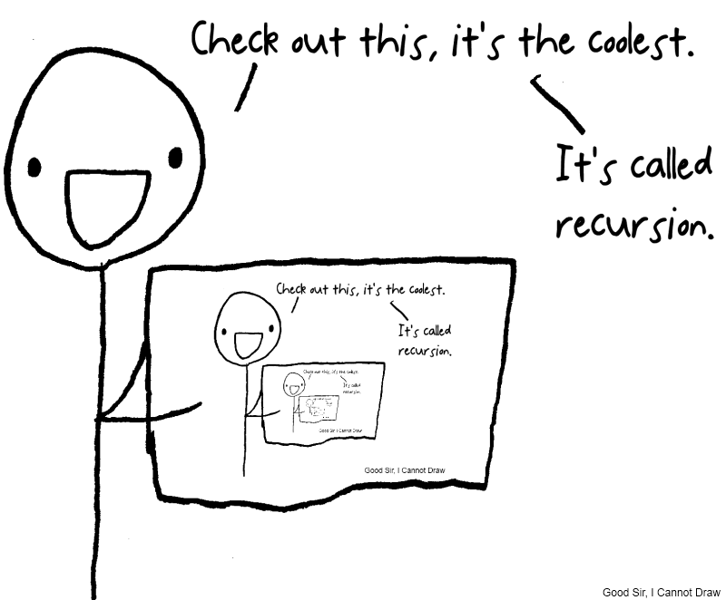
Recursion

Slide 32

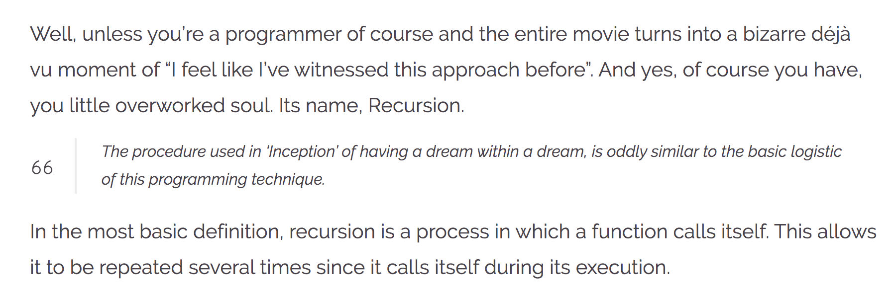
Recursion
https://wewrite.taleas.io/2018/11/14/why-inception-reminds-us-of-recursion/

Slide 33
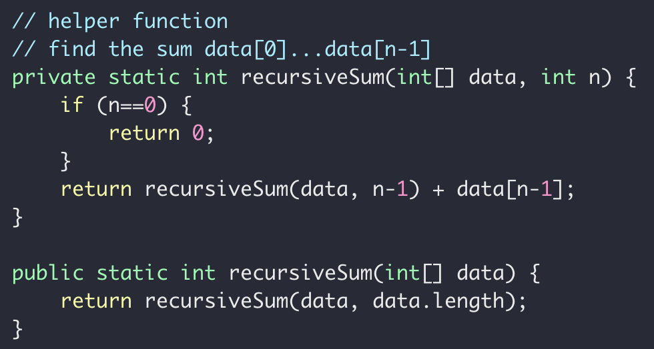
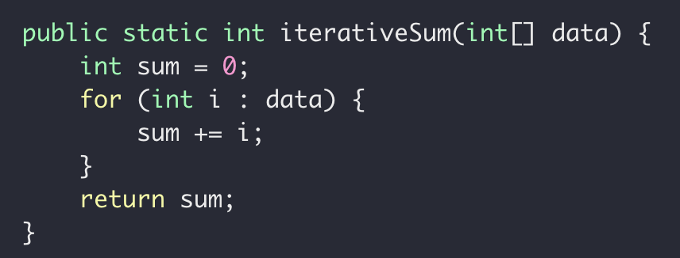
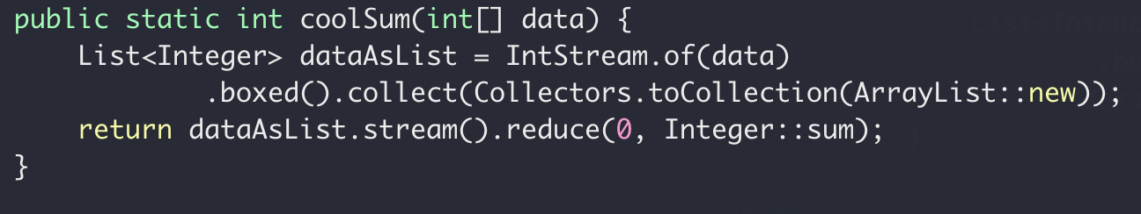
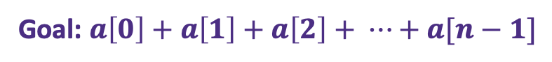
Recursive Sum
Goal: $a\left[0\right]+a\left[1\right]+a\left[2\right]+ ⋯+a[n−1]$
iterative
recursive
“modern”

Slide 34


Backtracking

Slide 35
Backtracking
TOO FAR!

Slide 36
Backtracking
NOP!

Slide 37

Backtracking

Slide 38
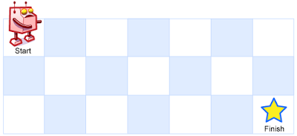


Recursion In Class Exercise: Unique Paths
A robot is located at the top-left corner of a grid
The robot can only move either down or right at any point in time.
$m$ rows
$n$ columns

Slide 39
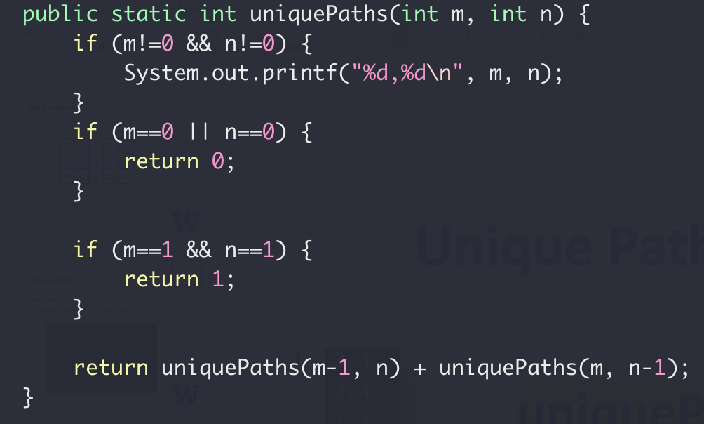



Unique Paths Tests
uniquePaths(3,4)
1
2
3
4
3,4
2,4
1,4
1,3
1,2
1,1
1
2,3
1,3
1,2
1,1
2
$m$ rows
2,2
1,2
1,1
2,1
1,1
3
$n$ columns
uniquePaths(1,1) $×4$

Slide 40
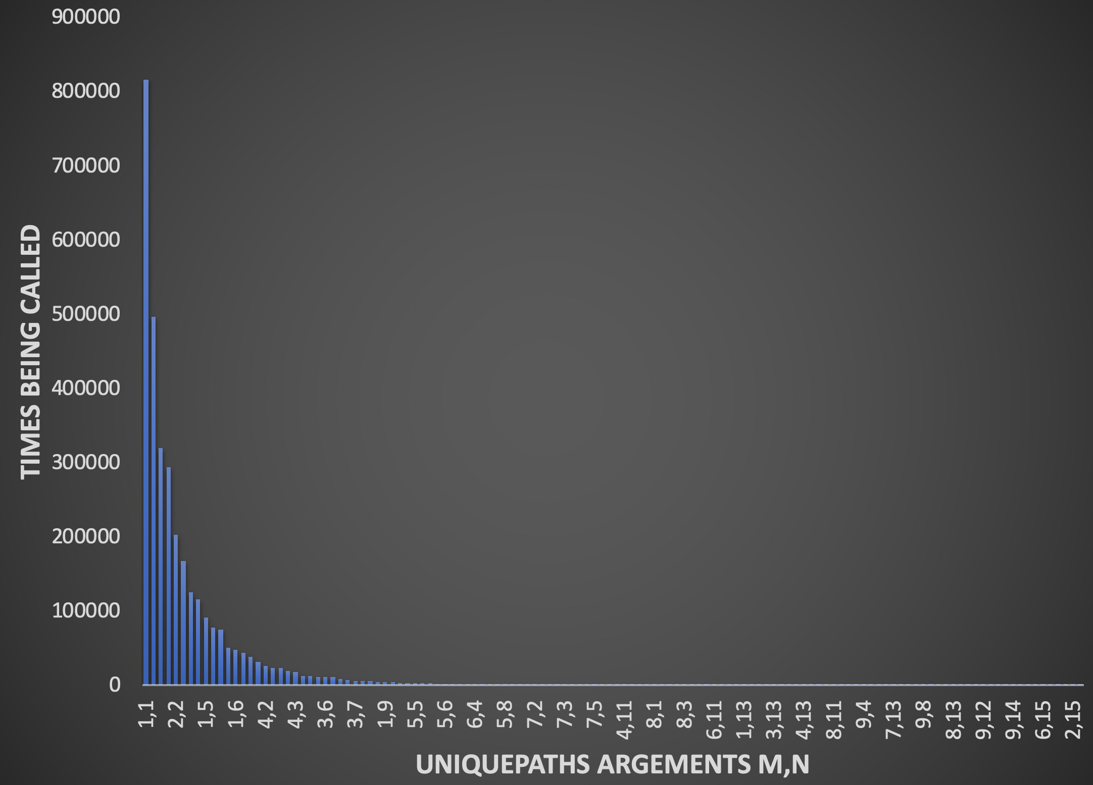
Unique Paths Tests
uniquePaths(10,15)
Repeated subproblem

Slide 41
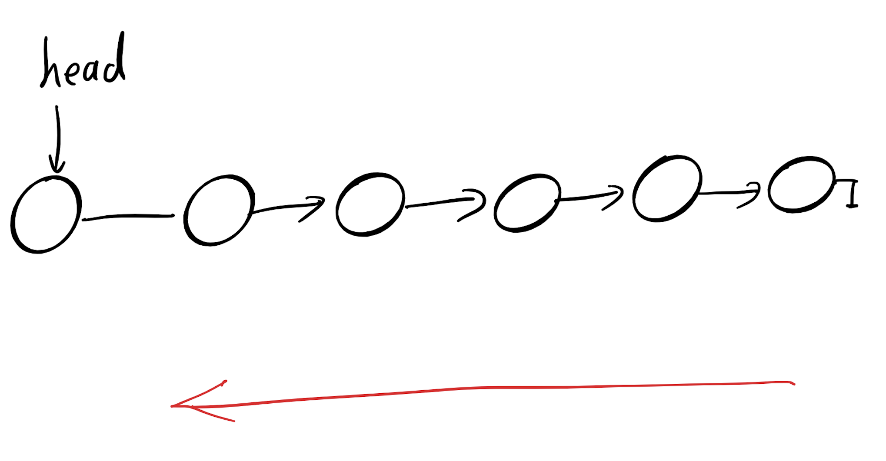
Recursion Summary
When to use recursion
Depth First Search

Slide 42
Recursion Summary
When to use recursion
Try All Options
?
?
?

Slide 43
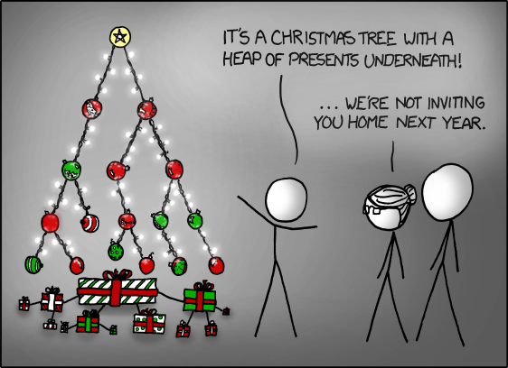
Binary Tree
https://www.reddit.com/r/ProgrammerHumor/comments/e6vc7w/shooting_children_out_of_trees/

Slide 44
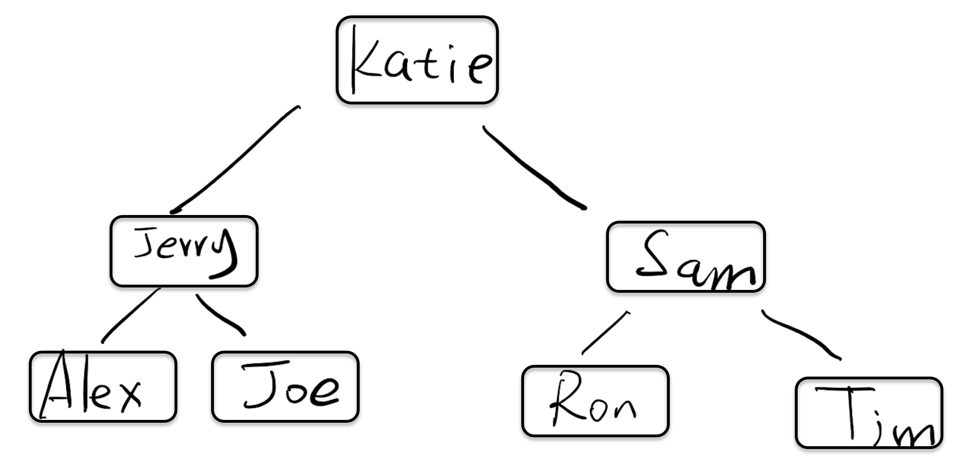
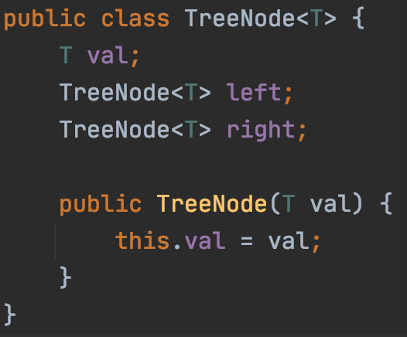

Slide 45
preorder: Root, Left, Right
Recursion
Middle node value
preorder(left subtree)
Preorder(right subtree)
Subproblem?
Stopping condition?
Node == null

Slide 46
inorder: Left, Root, Right
Recursion
Inorder(left subtree)
Middle node value
Inorder(right subtree)
Subproblem?
Stopping condition?
Node == null

Slide 47
postorder: Left, Right, Root
Recursion
Postorder(left subtree)
Postorder(right subtree)
Middle node value
Subproblem?
Stopping condition?
Node == null

Slide 48
Height of a tree
$$h_{0}$$
$$h_{1}$$
$$h_{2}$$
$$h_{0}= ?$$
$$h_{0}=max\left(h1, h2\right)+1$$

Slide 49
$$h_{0}=max\left(h1, h2\right)+1$$
$$h_{0}=max\left(3, 2\right)+1=3+1=4$$
$$h_{0}$$
$$4$$
8
$$h_{2}$$
$$h_{1}$$
$$2$$
$$3$$
3
10
2
14
1
6
4
7

Slide 50
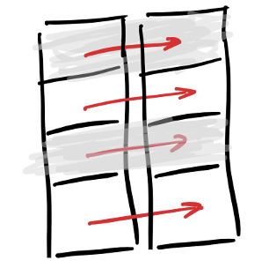
Dictionary (Map)

Slide 51
Hashing
Key x
Index y
“Key”
“Hash Key”
String
Integer

Slide 52
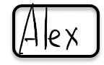
Key value pair: (K, V)
(K,V)
Hash function
6
Hash key
key K

Slide 53
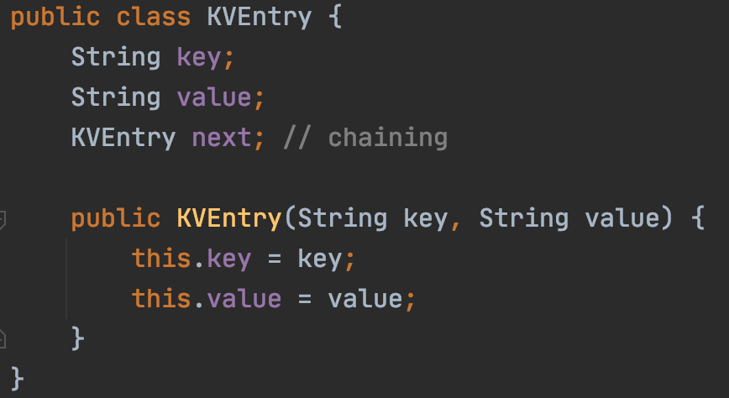
Collision
Sam
Ron
key=Sam
key=Ron

Slide 54
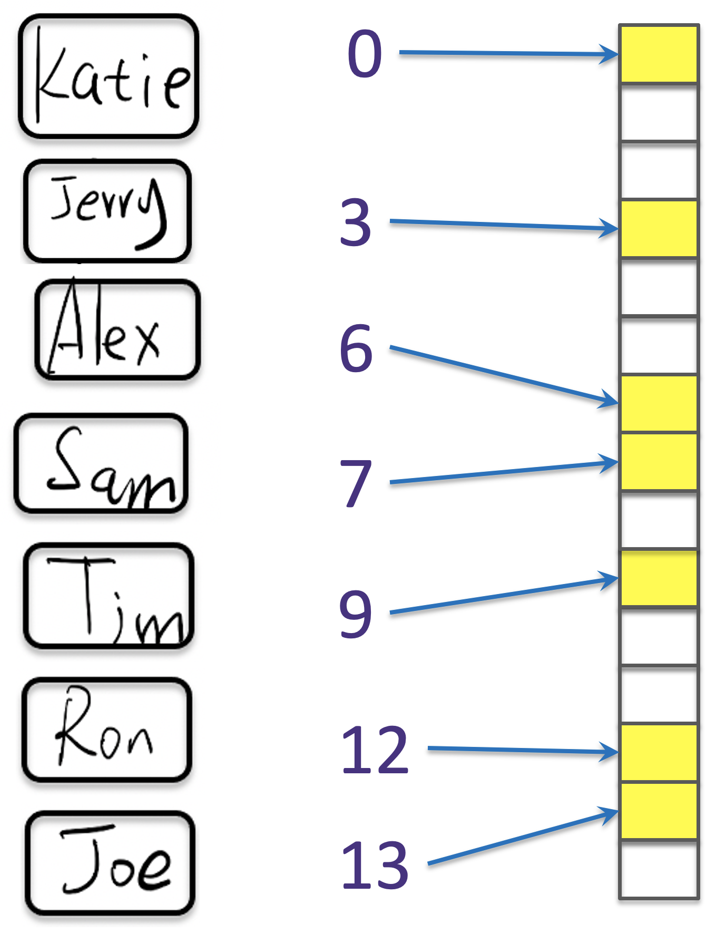
If there are 10,000 users
Each comparison takes 1 seconds
Sam
Ron
Alex
Jerry
Katie
Joe
Tim
2.78m ☹
~1s

Slide 55

Hashtable Application
"/", "/search", "/home"
Controller
Repository
Database
Service
Webpage

Slide 56
Cache
?
"/", "/search", "/home"
Controller
Repository
Database
Service
Webpage

Slide 57
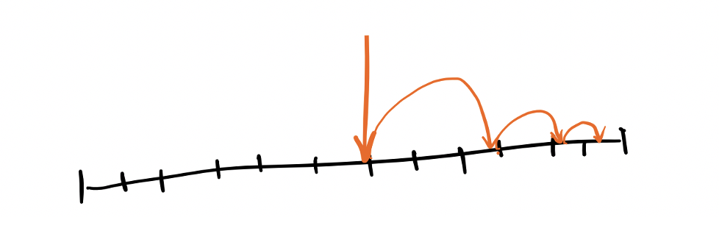
Searching Algorithm

Slide 58
Guess the number in my mind
I have a number in my mind between 1 and 10
How many guesses?

Slide 59
Guess the number in my mind
I have a number in my mind between 1 and 100
How many guesses?

Slide 60
Guess the number in my mind
I have a number in my mind between 1 and 100,000
How many guesses?

Slide 61
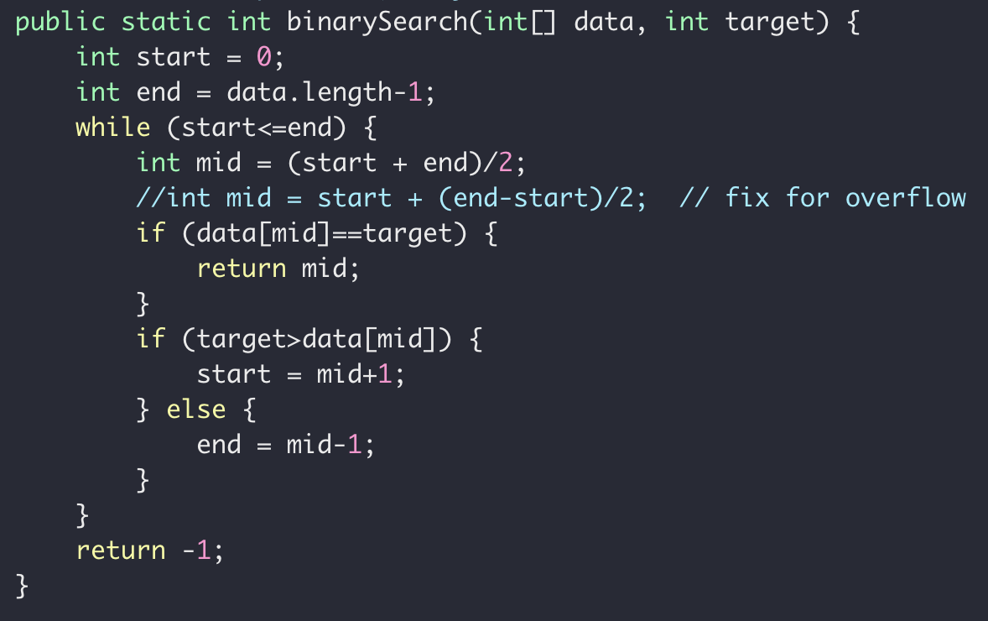
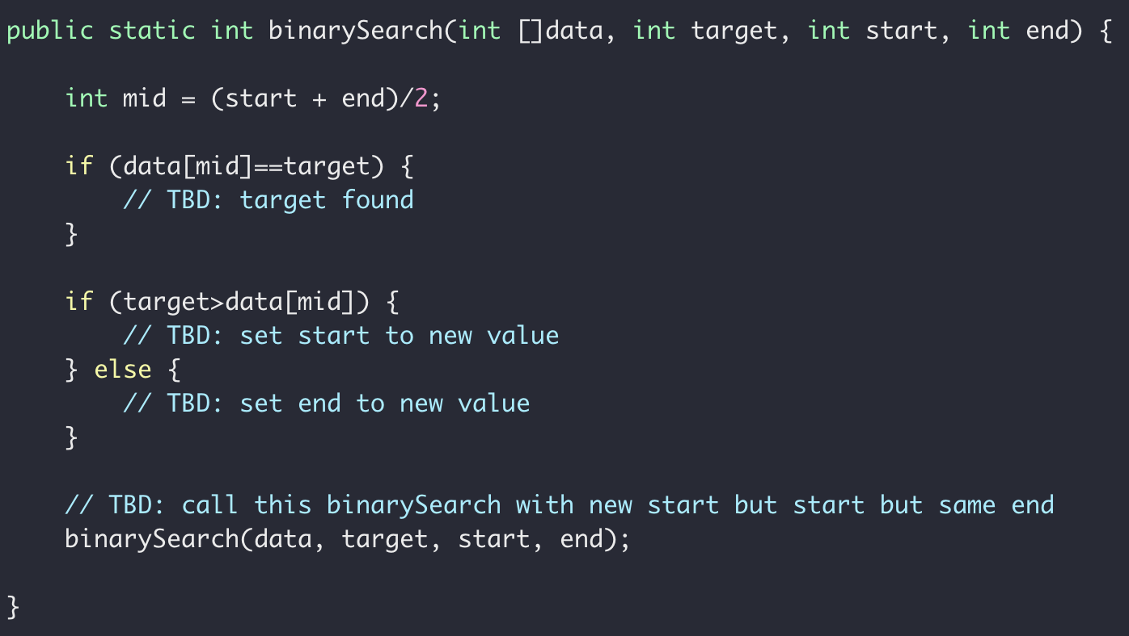
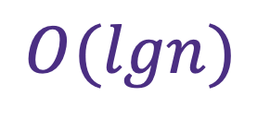
Recursive Binary Search
$$O(lgn)$$
Iterative
Recursive

Slide 62
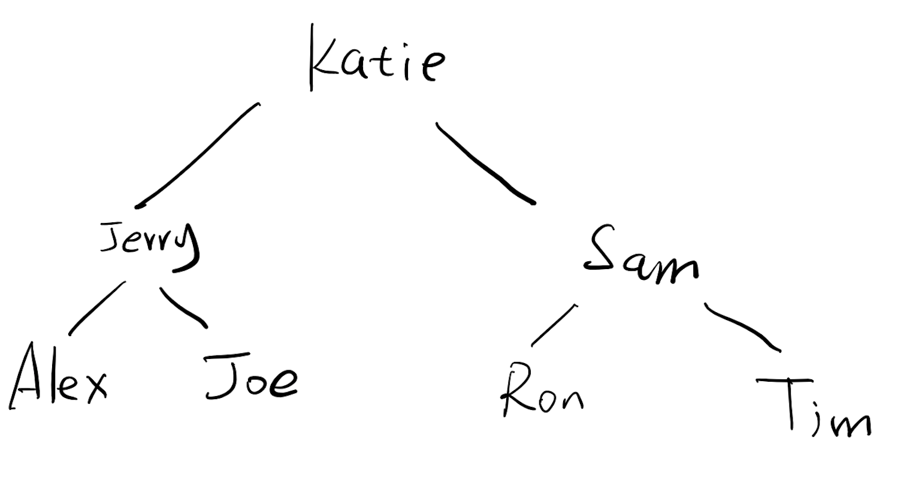
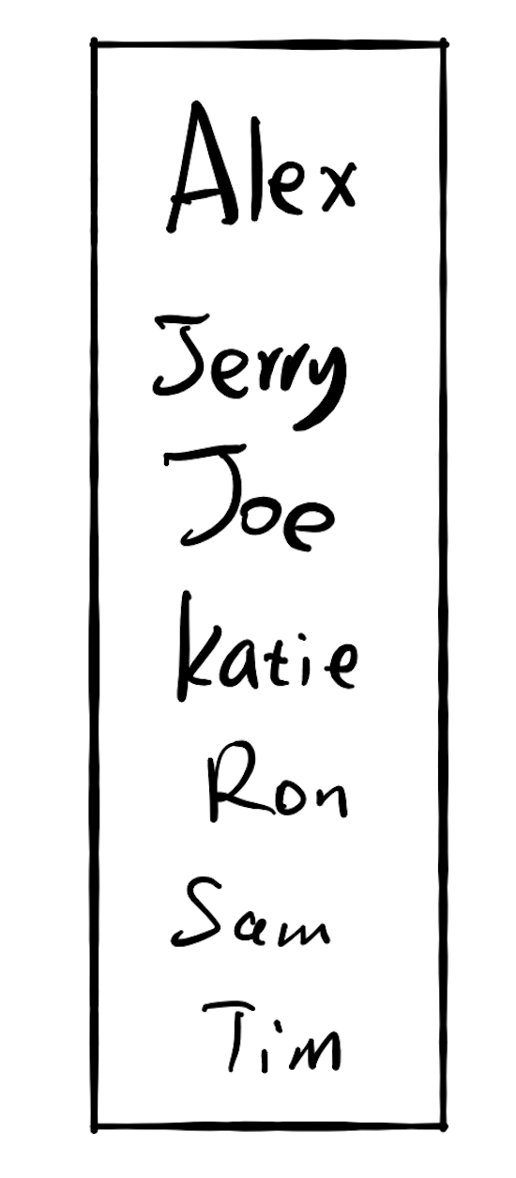
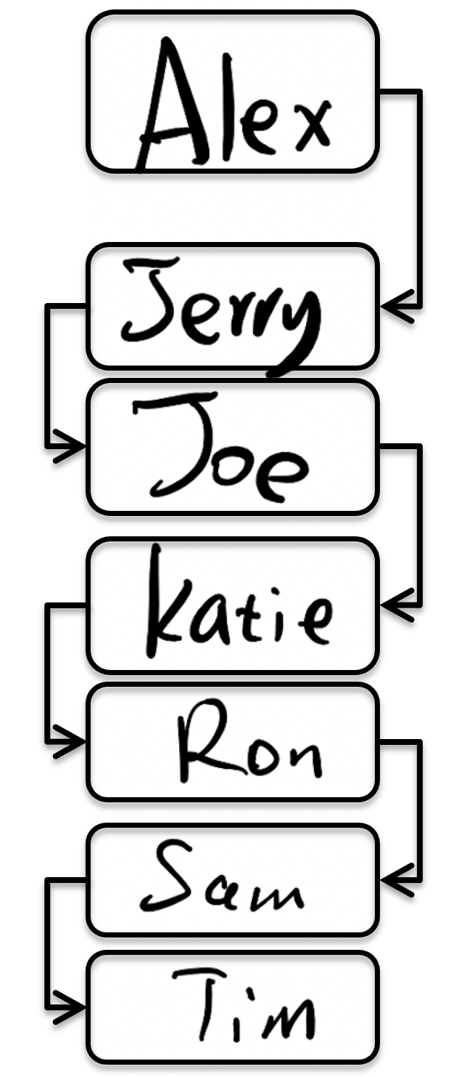
If there are 10,000 users
13s
Each comparison takes 1 seconds
13s
2.78m
~1s

Slide 63
If there are 10,000 users
Each comparison takes 1 seconds
Sam
Ron
Alex
Jerry
Katie
Joe
Tim
2.78m ☹
~1s

Slide 64
Sorting Algorithm & Complexity

Slide 65

Weighting 9 boxes
9 boxes, same size, equally heavy - except for one, which is a little heavier.
With a pair of balance scales, how to identify the heavier ball?

Slide 66


Sorting and Complexity
Bubble
Insertion
Quicksort
$$O(n^{2})$$
$$O(nlgn)$$

Slide 67



$$O\left(n^{2}\right) vs O(nlgn)$$

Slide 68
Complexity
Binary search
Remove an element from an array
Search in a single linked list
Remove an element from a single linked list
Search in a binary tree
Pop a value from a Stack
Search in a binary search tree
Add a value to a Queue
Search in a hashtable

Slide 69

Class Expectation
After this term, you will
Be confident writing code in Java with cool tools such as Intellij, Junit, Maven
Be confident with using source control tools Git and Github
Write clean code with solid tests
Have good understanding of data structure such as array, hashtable, list, tree
Understand how to compromise between time and space complexity
Have solved many technical problems commonly asked during interview
Have written your own text search engine (Watch out! Google!)
(hopefully) Have fun and know whether CS is what you like!

Slide 70






The End

Slide 71



Stay In Touch

